Slide 1
Donut on Demand (DoD)
Software Architecture Design (AT70.18)
Submitted to: Dr. Chaklam Silpasuwanchai
Made to Order Donuts Online Shop
Project Members:
Cedric Le Mercier - st122004 Titouan Le Mao - st122014

Slide 2
Table of contents
Background
Stakeholders
Quality Attribute Analysis
Functional Requirements
Architectural design
Planning tools
Demo
Database Testing
UI Testing

Slide 3
Background

Slide 4
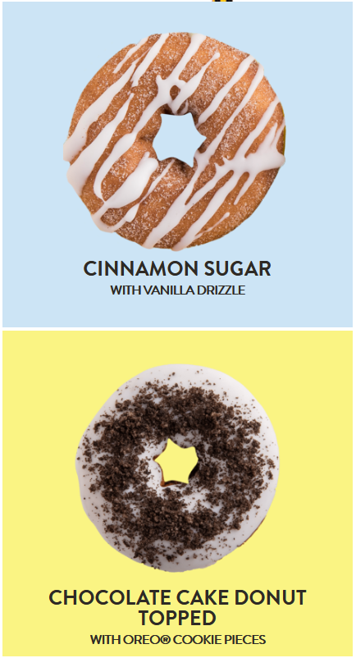
Background
South East Asia 2nd Largest Market of Doughnuts (8 billion usd)
Doughnuts are not just sweet dessert doughnuts, but different varieties (glazed, chocolate, etc) for different occasions (dessert, coffee, etc)
We want to create an innovative service at crossroads of e-Shop and drive in
Similar to Cakes or cupcakes made of demand
No queue, no out of stock, browse and customize different varieties in a single place

Slide 5
2. Stakeholders

Slide 6
Stakeholders
Customer
Manager
Order Supervisor
Cashier

Slide 7
3. Quality Attribute Analysis

Slide 8
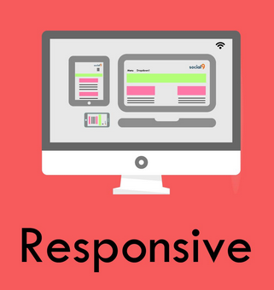
Quality Attribute Analysis
Usability (High)
The app should be compatible with the most popular browsers (Chrome, Firefox, Safari and Internet Explorer)
The app should be responsive to any device
The app has to be easy to use and has to only require a few seconds to understand what it does, especially for customers

Slide 9
Quality Attribute Analysis
Performance (High)
The process to completing an order should take less than 5 steps (or screens)
The application should be able to handle a high traffic load
Response time for any action should be less than 2s

Slide 10
Quality Attribute Analysis
Security (Moderate)
Restricted urls based on roles
Storing customer information in the future
Availability (Moderate)
Scalability (Moderate)

Slide 11
4. Functional Requirements

Slide 12
Functional Requirements
Customer
Customers should be able to place an order for donuts
Choosing a date and time to pick up
Choosing a shop
Receive a confirmation email

Slide 13
Functional Requirements
Manager
Manager should be able to track sales statistics
Manager should be able to have an overview of popular recipes
Manager should be able to add/edit/delete donut recipes
Manager should be able to add new Employee to his shop

Slide 14
Functional Requirements
Order Supervisor
Order supervisor should be able to manage current orders to organise the order pick up, and update which are ready

Slide 15
Functional Requirements
Cashier
Cashier should validate the withdrawal of an order and input revenue

Slide 16
5. Architectural Design

Slide 17
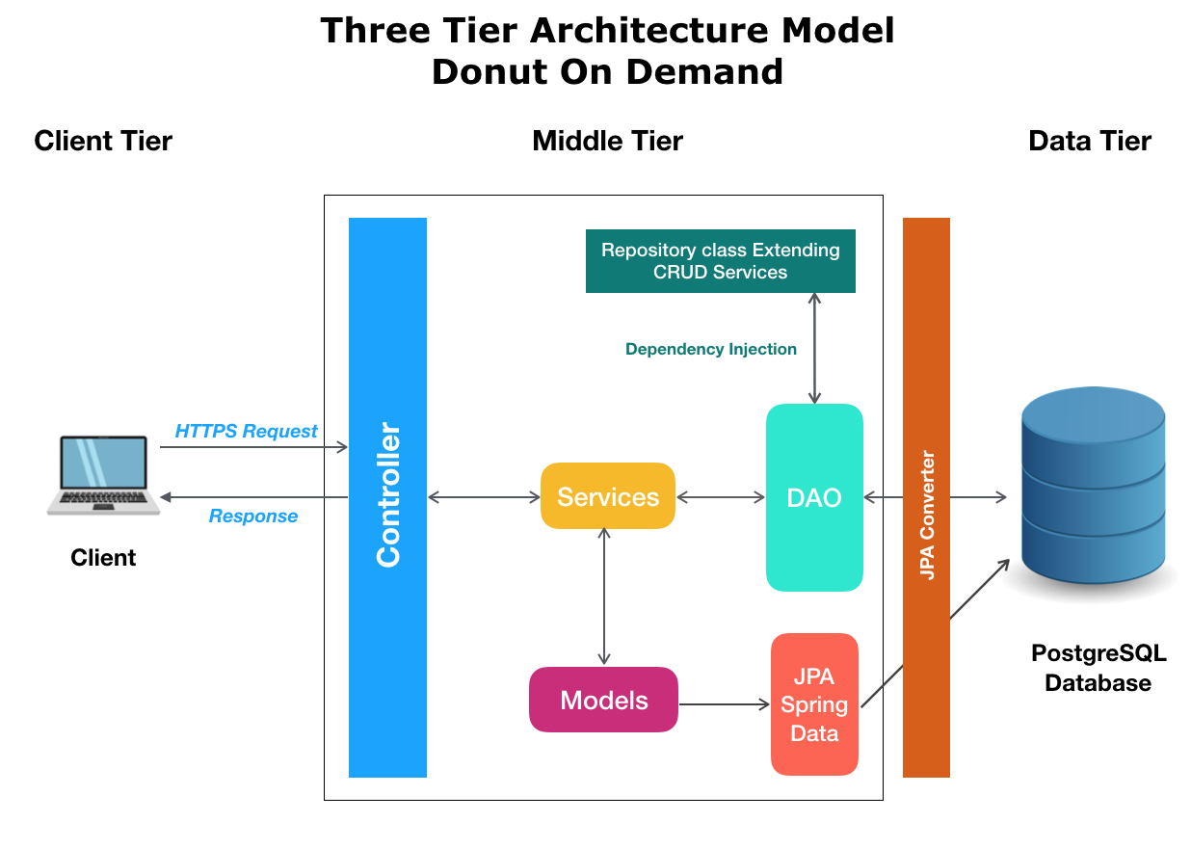
Architectural Design

Slide 18
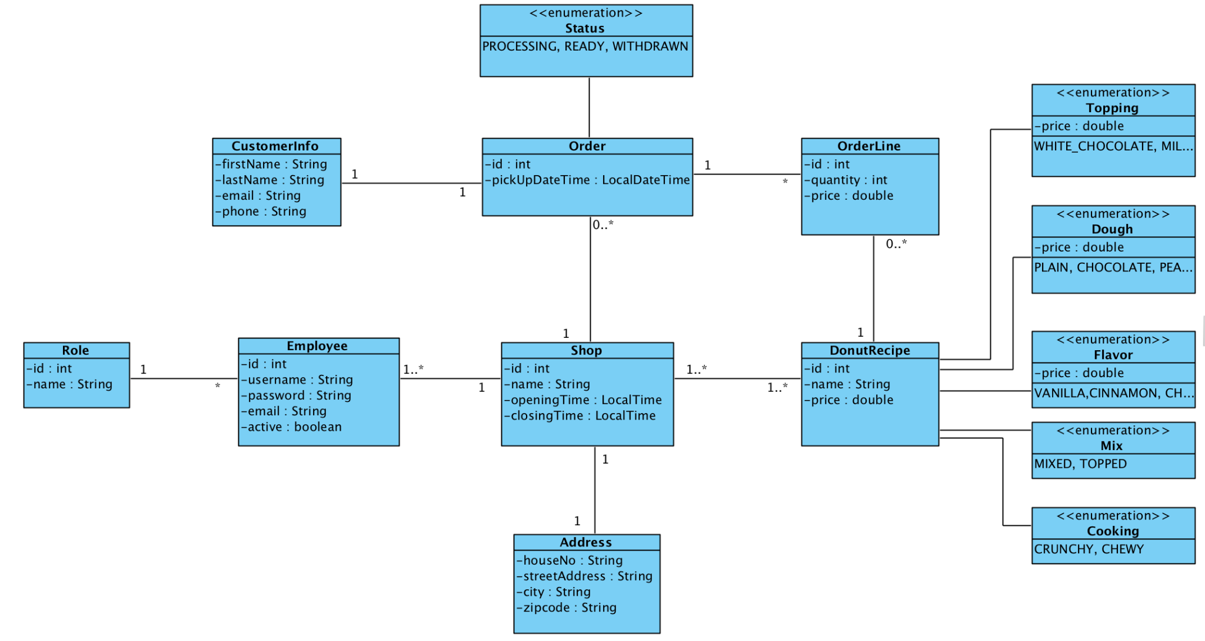
Class Diagram

Slide 19
6. Planning tools

Slide 20
Tools
Github features
Issues
Labels
Milestones
Kanban project

Slide 21
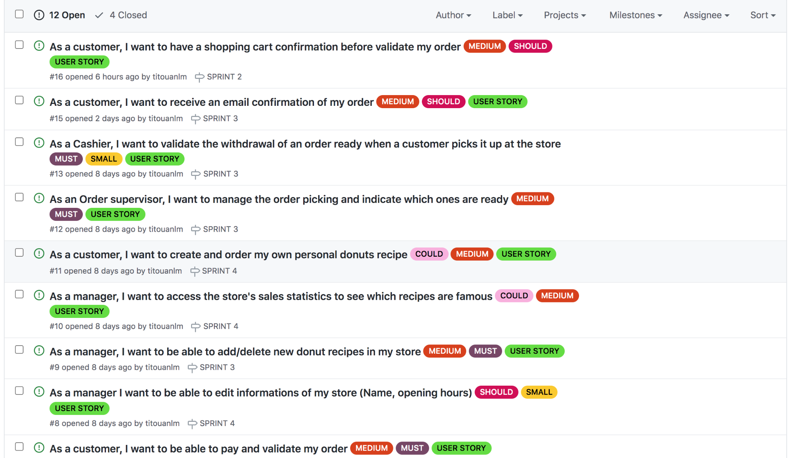
Issues & Labels

Slide 22
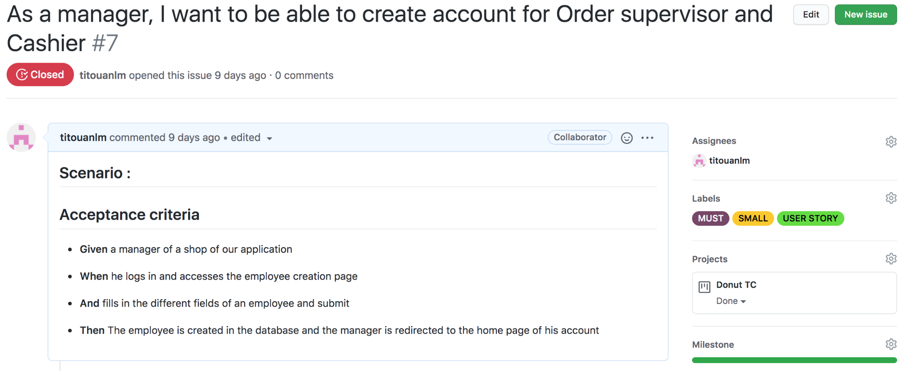
Acceptance Criteria

Slide 23
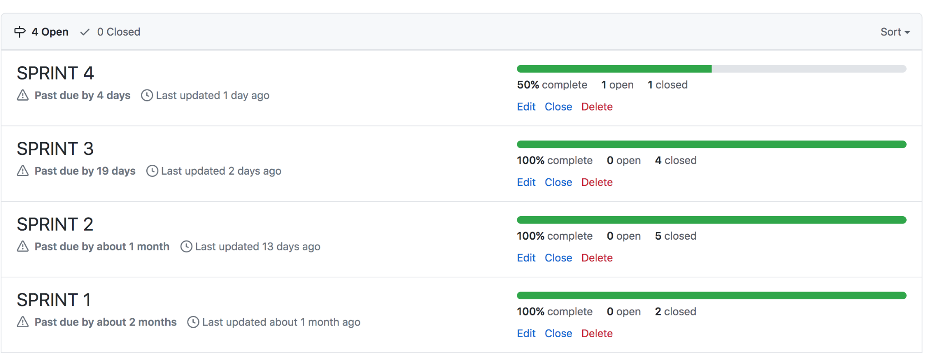
Milestones

Slide 24
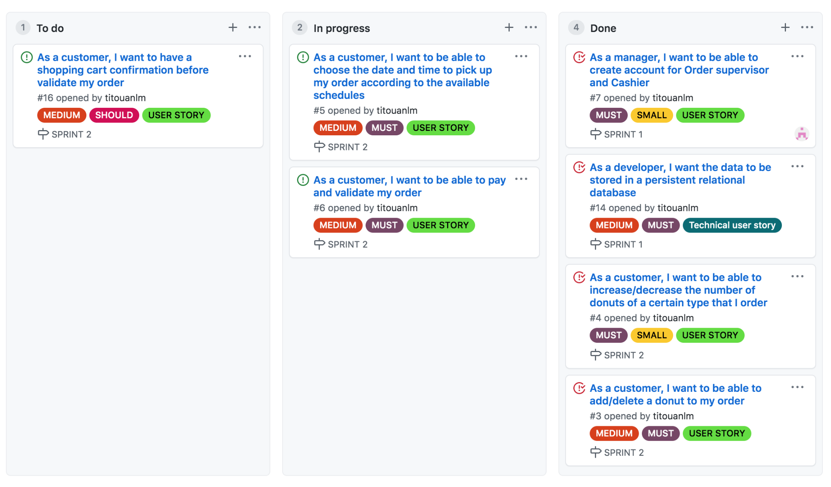
Kanban project

Slide 25
8. Demo

Slide 26


Slide 27
9. Database Testing

Slide 28
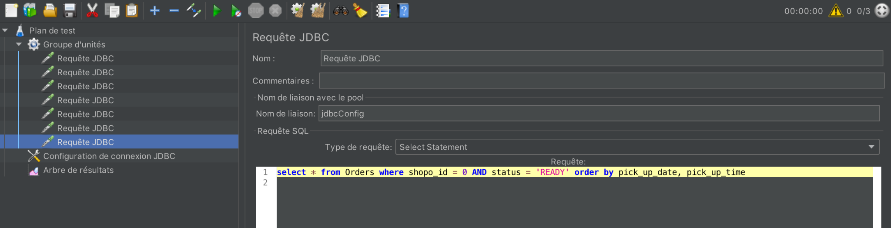
Database Performance Testing with JMeter

Slide 29
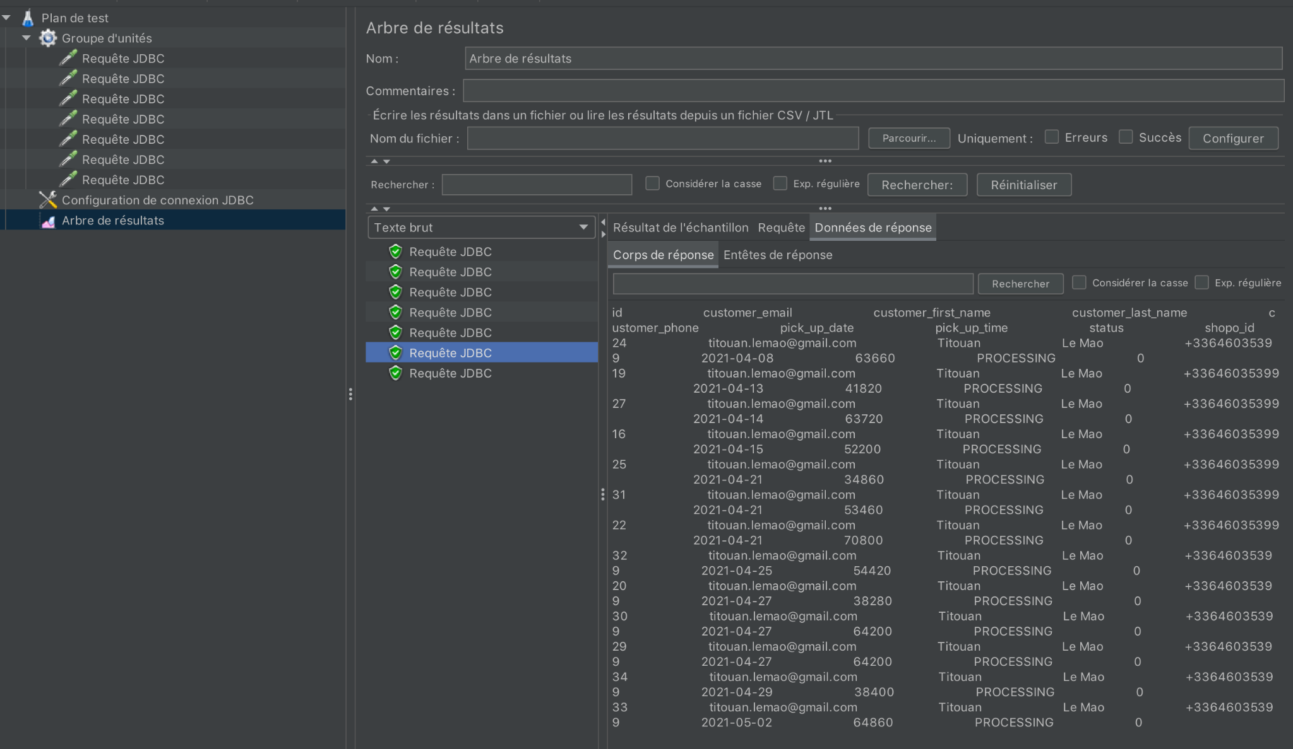
Database Performance Testing with JMeter

Slide 30
10. UI Testing with Selenium

Slide 31

Tools & Libraries for automation of web browsers, useful for Web UI Testing
Web UI Testing
Feature testing, testing an app like how a user would do
End-to-end with all parts tested together through browser (front-end, back-end)
Can be expensive

Slide 32

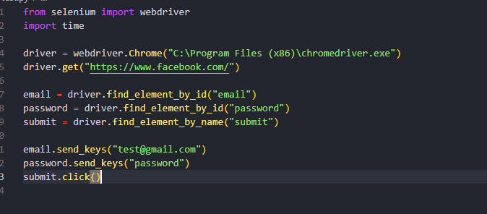
Selenium Webdriver
API to Control the behavior of browsers

Slide 33
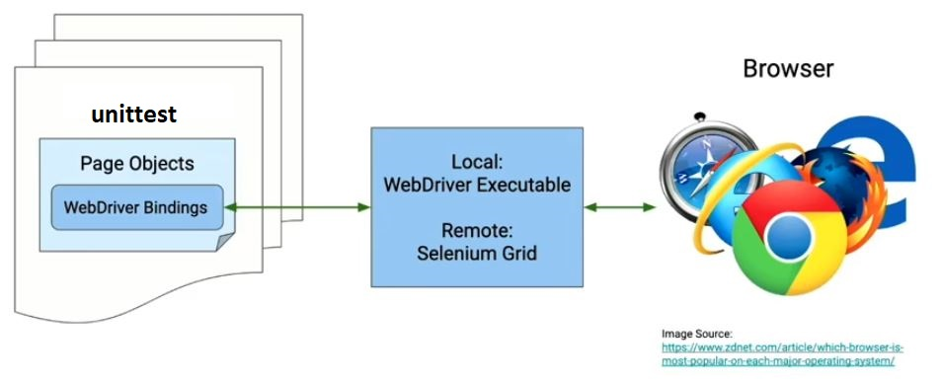
Testing with Selenium and Python unittest
Notes:
We can use Selenium webdriver combined with the integrated python unit test framework called python unittest, so we can automate a range of actions and get kick test results
The test themselves are Page Object classes and we are going to run our unit tests inside them, by making webdriver calls
Webdrivers calls going to an executable that you saved on your computer, which is going to open the browser and send the commands (clicks, input, getting data…) that you wrote
Selenium Grid is more advanced and allow for cross browser testing, but we are not going into that today

Slide 34
Demo Use Cases
Can a non-logged in user access all public pages and add product to cart?
Can an order supervisor access /manageOrderPicking but not admin areas such as /createEmployee?
Can the manager log in properly and create basic recipes for doughnuts?
Notes:
We can use Selenium webdriver combined with the integrated python unit test framework called python unittest, so we can automate a range of actions and get kick test results
The test themselves are Page Object classes and we are going to run our unit tests inside them, by making webdriver calls
Webdrivers calls going to an executable that you saved on your computer, which is going to open the browser and send the commands (clicks, input, getting data…) that you wrote
Selenium Grid is more advanced and allow for cross browser testing, but we are not going into that today

Slide 35
Demo

